Slide 1

Lecture 10: IT in transport
Hoger Mahmud

Slide 2



Lecture outline
What is transport
E-Transport
Why we need IT in transport
Hardware used in transport
Software used in transport
Examples of transport
2

Slide 3
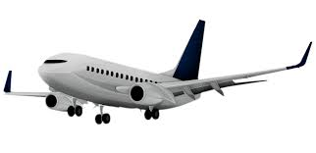
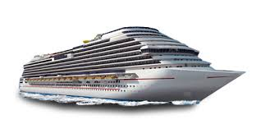
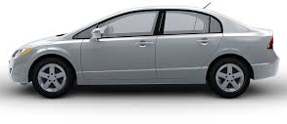
What is Transportation
Transportation: the action of transporting someone or something or the process of being transported
Transportation types
Air - transport
Sea - transport
Land - transport
3

Slide 4
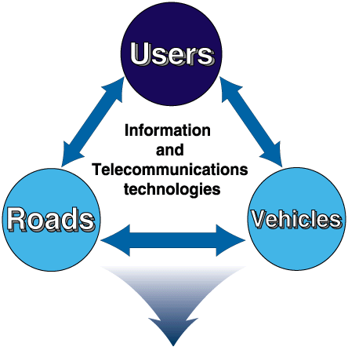
What is Transportation
e-Transportation: Facilitating transport through the use of information technology
Transport system
4

Slide 5
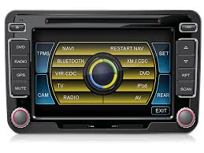
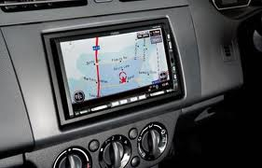
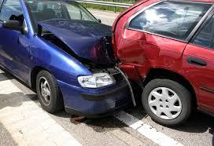
Why we need IT in Transportation
Accident: to reduce the number of car accidents
Entertainment: to provide better entertaining facilities
Direction: to find our ways more easily
Durability: make transportation vehicles last longer
5

Slide 6
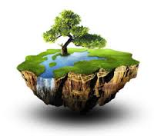
Why we need IT in Transportation
Efficiency: make transportation vehicles more fuel efficient
Affordable: make them cheap to buy
Reliable: make transportation more reliable
Environment friendly : make transportation produce less harmful emission
6

Slide 7
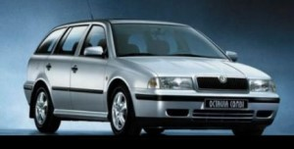
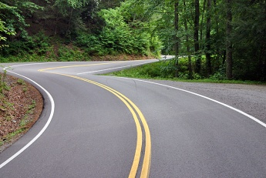
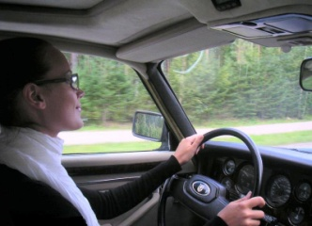
Intelligent Transportation system
Connected vehicle
Vehicle to vehicle
Vehicle to infrastructure
Communicate appropriately with driver
Real time information
All roads
All modes
All the time
7

Slide 8
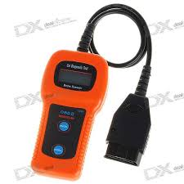
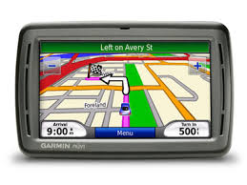
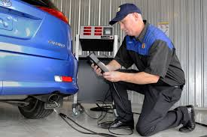

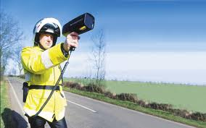
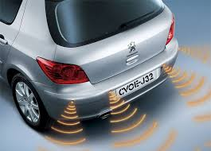
Hardware used in transportation
Digital car tester
SatNave
Emission reader
Traffic lights
Speed camera
Car sensors
8

Slide 9
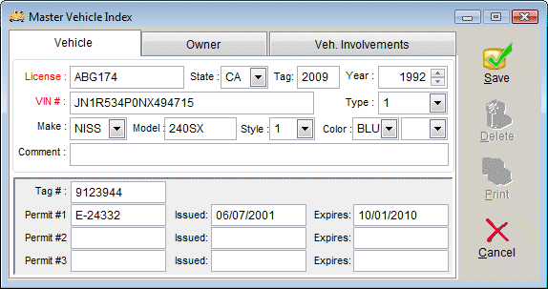
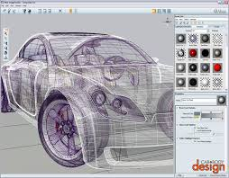
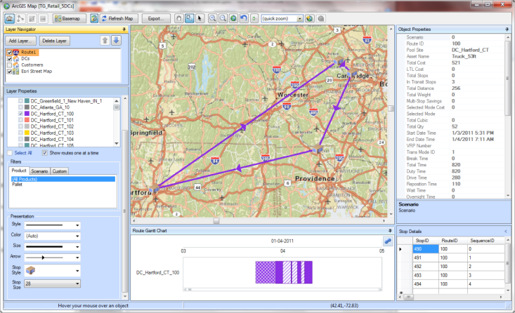
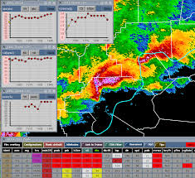
Software used in transportation
Car Reg record
Car design
Traffic maps
Weather data
9

Slide 10
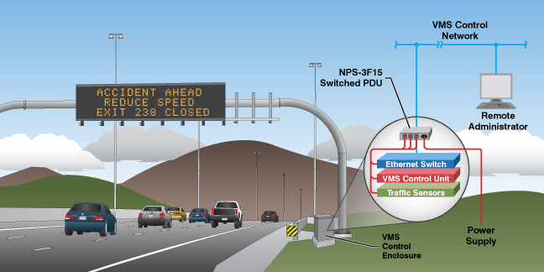
Use of IT in transport example
10

Slide 11
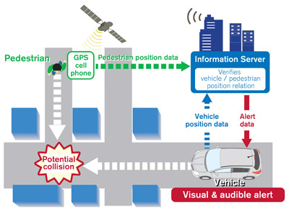
Use of IT in transport example
11

Slide 12

Thank you
?

